Slide 1
Traditional Poster Suppliments

Slide 2
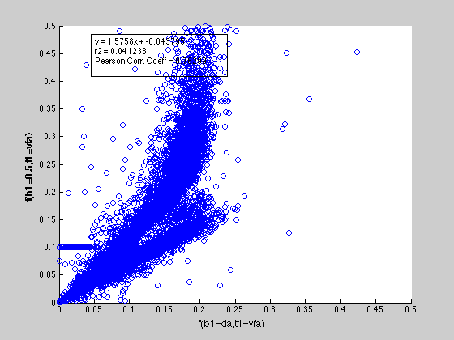
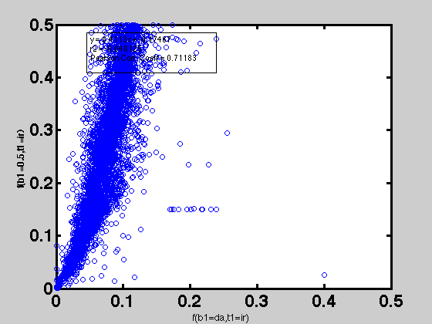
qMT F parameter comparison
B1 measured vs. B1 flat = 0.5
VFA | IR

Slide 3
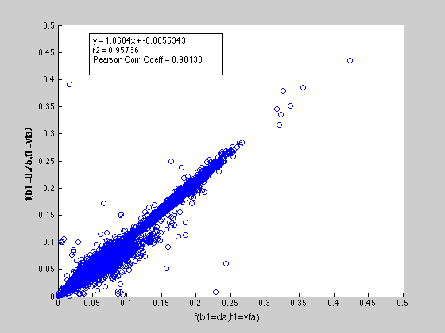
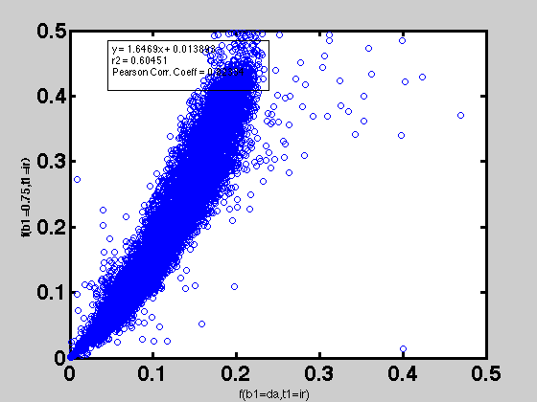
qMT F parameter comparison
B1 measured vs. B1 flat = 0.75
VFA | IR

Slide 4
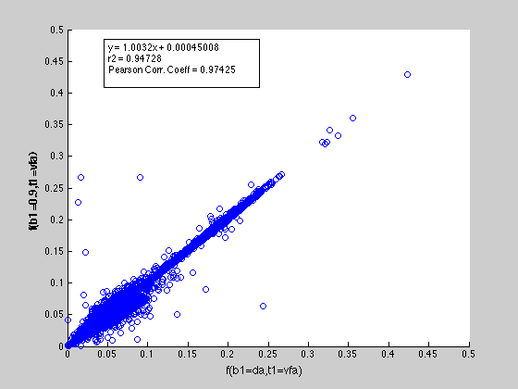
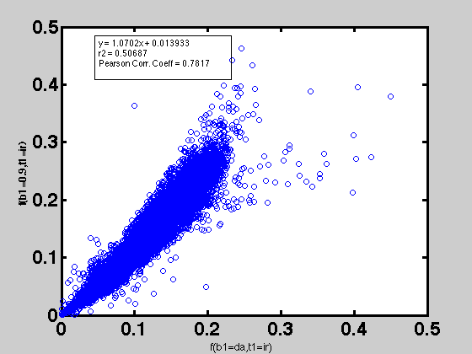
qMT F parameter comparison
B1 measured vs. B1 flat = 0.9
VFA | IR

Slide 5
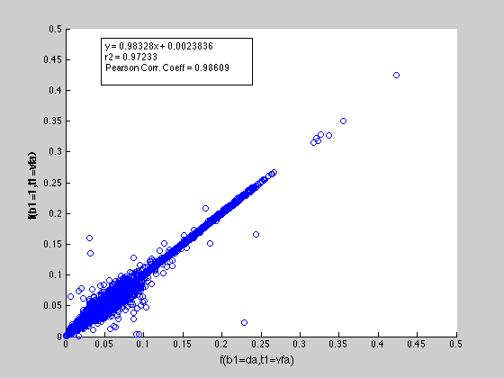
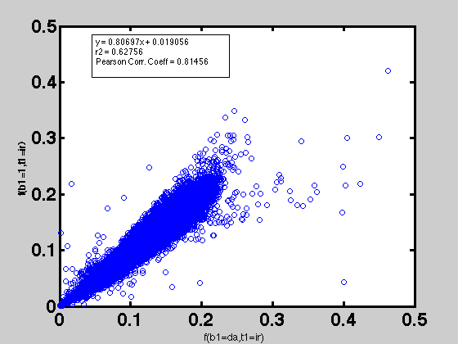
qMT F parameter comparison
B1 measured vs. B1 flat = 1
VFA | IR

Slide 6
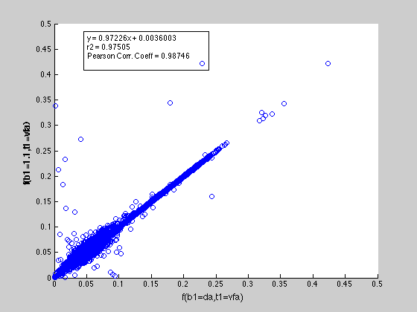
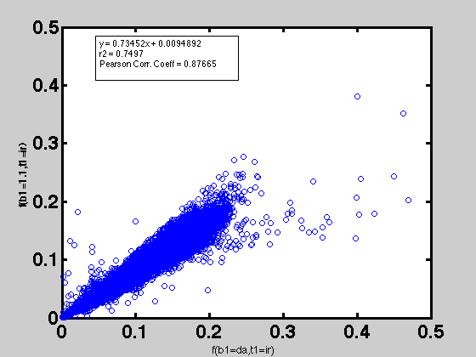
qMT F parameter comparison
B1 measured vs. B1 flat = 1.1
VFA | IR

Slide 7

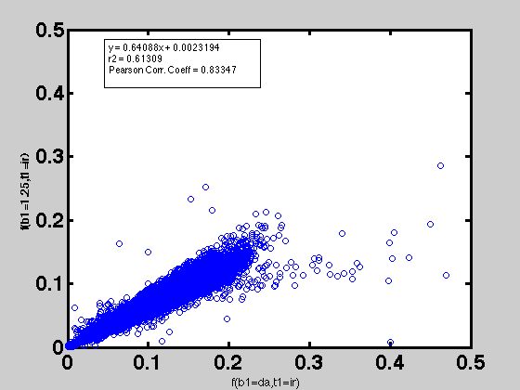
qMT F parameter comparison
B1 measured vs. B1 flat = 1.25
VFA | IR

Slide 8
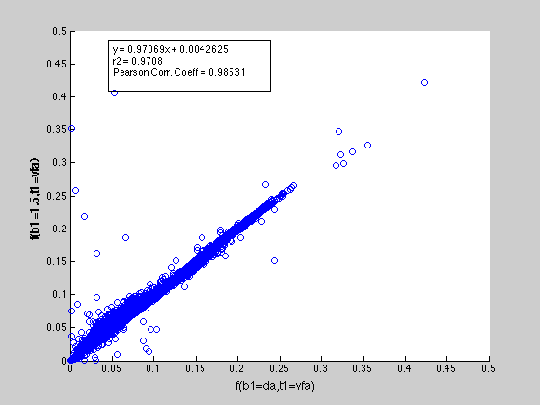
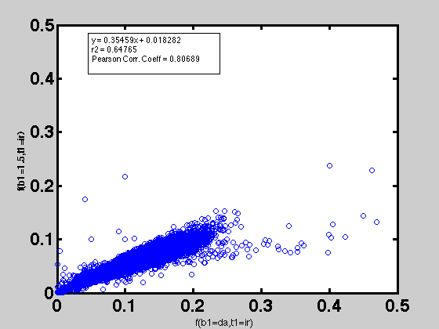
qMT F parameter comparison
B1 measured vs. B1 flat = 1.5
VFA | IR

Slide 9
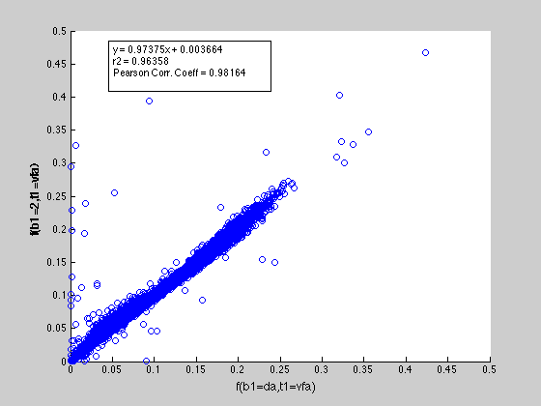
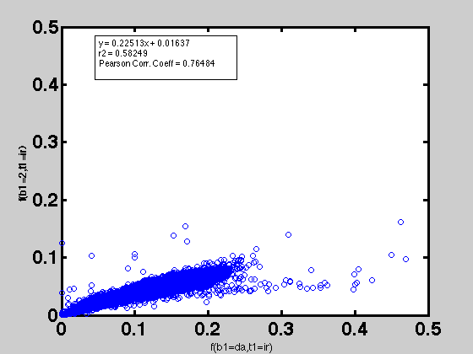
qMT F parameter comparison
B1 measured vs. B1 flat = 2
VFA | IR

Slide 10
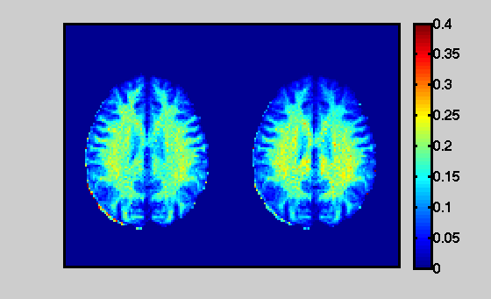
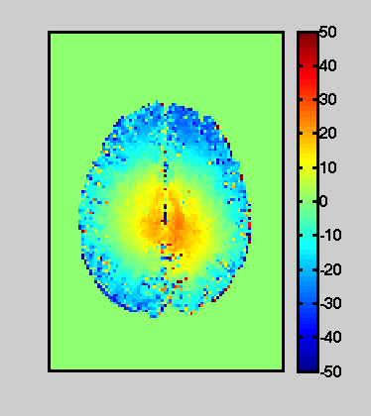
qMT F map
% Difference
IR+(B1=DA)
IR+(B1=1)

